Slide 1
Center for Religious Studies
Executive Plan 2022-2024
Massimo Leone
Fondazione Bruno Kessler
mleone@fbk.eu https://isr.fbk.eu/

Slide 2
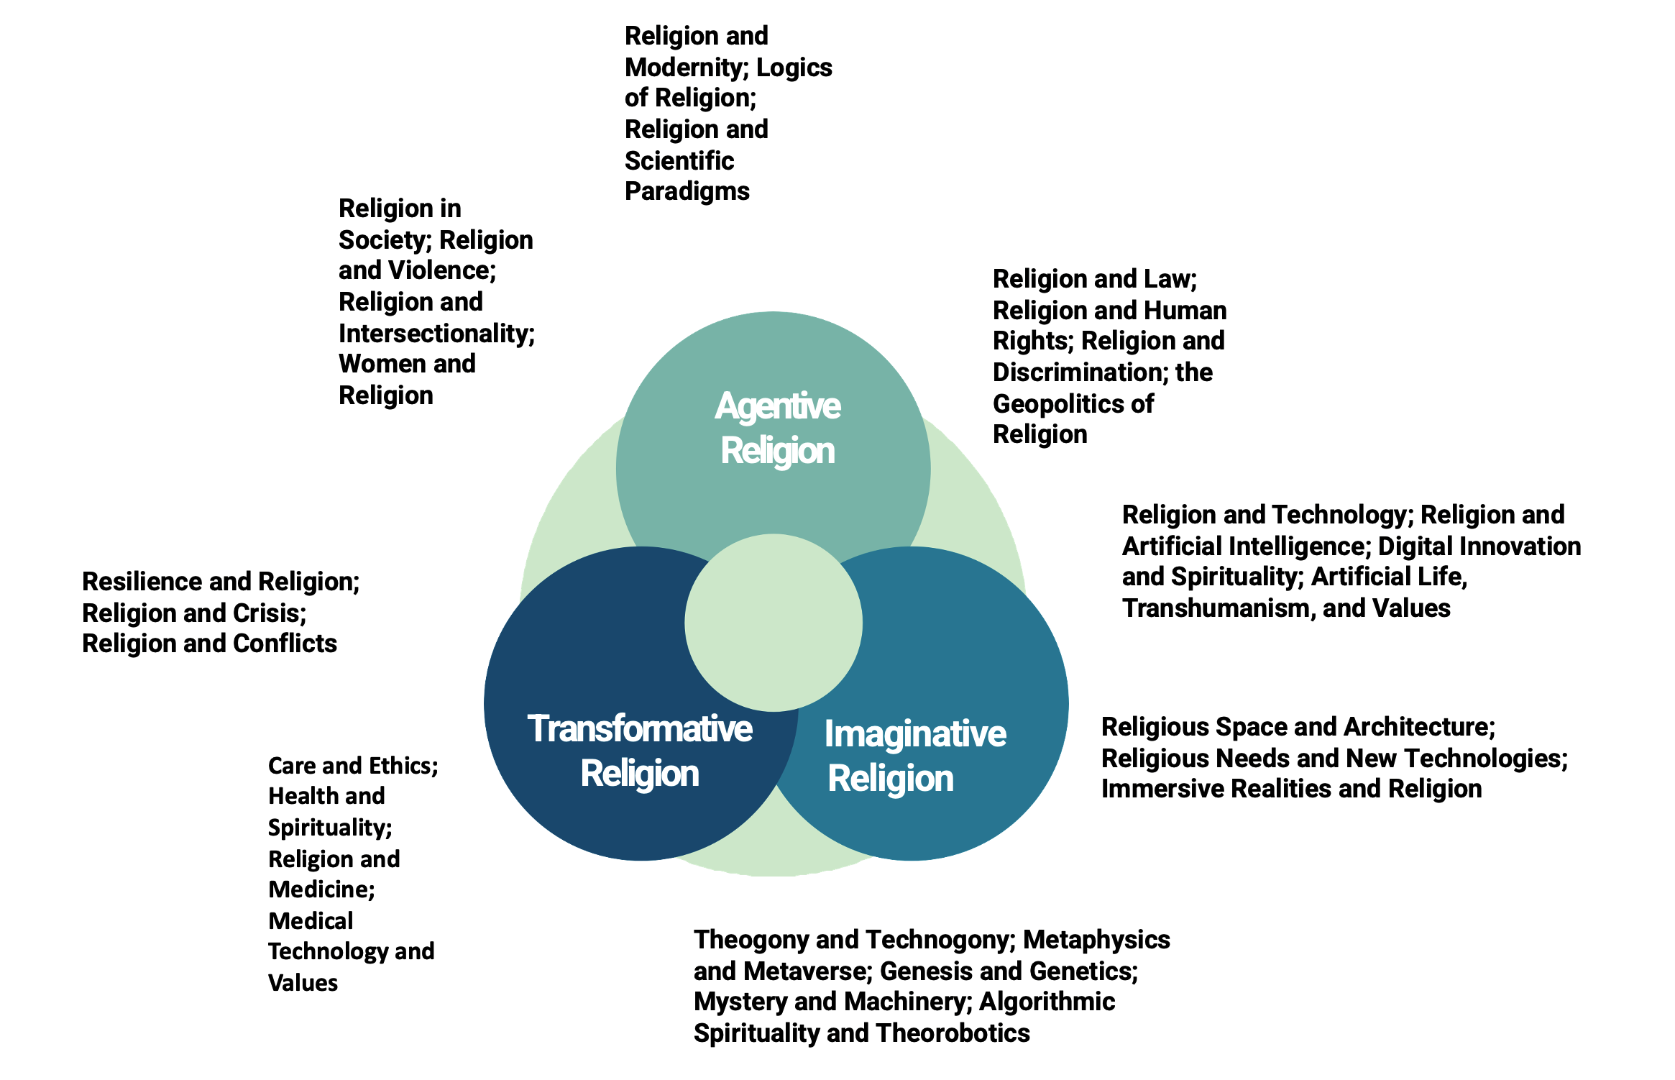
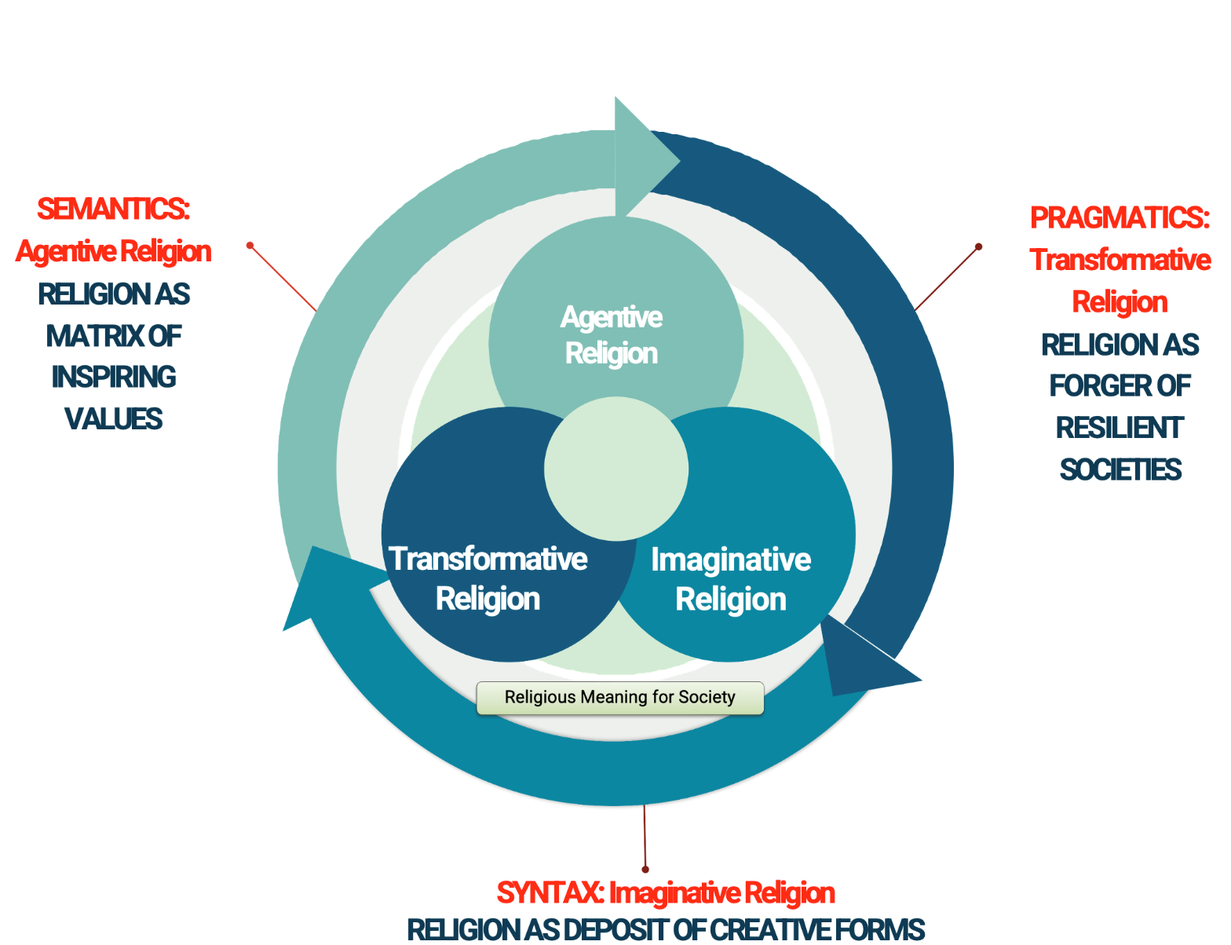
ISR Executive Plan: Summary
Objectives: HERMES
Competences: 8 domains
Heightening awareness
Excelling in research
Responding to the social demand of knowledge
Mapping the role of religion and ethics
Exerting assessable positive impact
Securing long-term sustainability
Strategy: 3 Axes
page 2

Slide 3
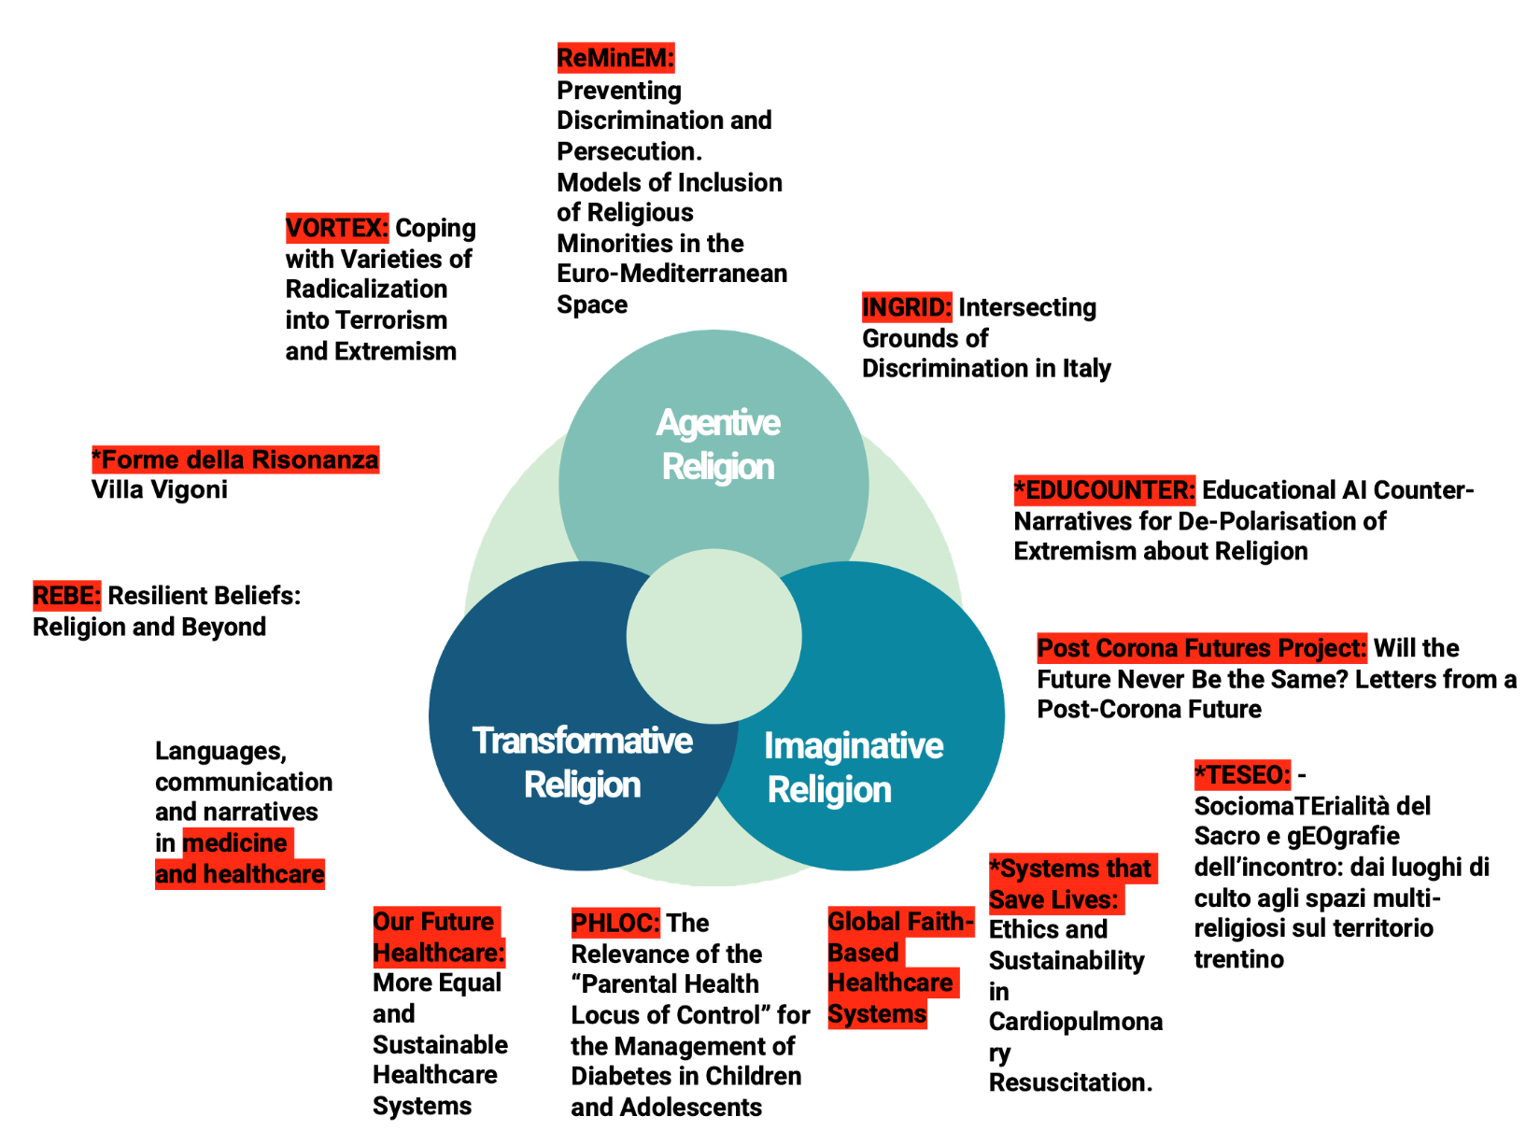
ISR Organization: Synopsis
Tactics: 4 pillars
People: 16 researchers
People
16 Researchers (9 females, 7 males)
1 Director
4 Full-Time Researchers
6 Part-Time Researchers
2 Research Fellows
1 PhD Student
1 Distinguished Fellow
1 Intern
Costs: 559 K€
Revenues: 97 K€
Self-funding: 17%
Budget
Synergies: 3 vectors
Projects
page 3
Notes:
Complex process control
Virtual and Extended Reality
Predictive models
Critical Systems
Geomatics
Predictive maintenance

Slide 4
Center for Religious Studies Vision - Mission - Objectives
Vision
Religion is an essential ganglion of cultures and societies; it has exerted enormous influence in the past; it is still active as a background force of modernity.
The challenge is to ensure that religion persists as an inspiring matrix of values to promote peace, offer freedom, achieve sustainable development, combat social exclusion and discrimination, and respect cultural diversity.
Mission
Conduct the highest quality research and support investigator-driven frontier inquiries about religion and ethics, on the basis of scientific excellence.
Objectives
Excellence in research in key areas for religious studies.
Responding to the social demand of knowledge about religion and ethics.
Mapping the role of religion and ethics in cultural and societal transformations.
Assessable positive impact on key religious and ethical challenges.
Long-term sustainability strategy based on research-impact accumulation.
page 4

Slide 5
Center for Religious Studies Strategy Overview
PRAGMATICS: Transformative Religion
RELIGION AS FORGER OF RESILIENT SOCIETIES
SEMANTICS: Agentive Religion
RELIGION AS MATRIX OF INSPIRING VALUES
Agentive Religion
Transformative
Religion
Imaginative
Religion
Religious Meaning for Society
SYNTAX: Imaginative Religion
RELIGION AS DEPOSIT OF CREATIVE FORMS
page 5

Slide 6
Center for Religious Studies Contents
The Center for Religious Studies
Executive Plan
Competences
Projects
FBK Synergies
Goals
Details
Conclusions
page 6

Slide 7
The Center for Religious Studies

Slide 8
The Center for Religious Studies Key Figures (2022)
Personnel
16 Researchers (9 females, 7 males)
1 Director
4 Full-Time Researchers
6 Part-Time Researchers
2 Research Fellows
1 PhD Student
1 Distinguished Fellow
1 Intern
Budget
461 K Euro (Personnel + Costs – Revenues)
420 K Euro personnel
138 K Euro other costs (including 30 K Euro library)
97 K Euro revenues
Research excellence
Research Journal “Annali”
“A” category ANVUR
Book Series Zordan Lectures
Funding
97 K (17 % self-funding)
74 K Euro EU projects
10 (and 6 fully externally funded) projects
page 8

Slide 9
Executive Plan

Slide 10
Research Competences
Religion and Modernity; Logics of Religion; Religion and Scientific Paradigms
Religion in Society; Religion and Violence; Religion and Intersectionality; Women and Religion
Religion and Law; Religion and Human Rights; Religion and Discrimination; the Geopolitics of Religion
Agentive Religion
Religion and Technology; Religion and Artificial Intelligence; Digital Innovation and Spirituality; Artificial Life, Transhumanism, and Values
Resilience and Religion; Religion and Crisis; Religion and Conflicts
Transformative Religion
Imaginative Religion
Religious Space and Architecture; Religious Needs and New Technologies; Immersive Realities and Religion
Care and Ethics; Health and Spirituality; Religion and Medicine; Medical Technology and Values
Theogony and Technogony; Metaphysics and Metaverse; Genesis and Genetics; Mystery and Machinery; Algorithmic Spirituality and Theorobotics
page 10

Slide 11
Research Projects
ReMinEM:
Preventing Discrimination and Persecution. Models of Inclusion of Religious Minorities in the Euro-Mediterranean Space
* = Projects submitted currently under evaluation for possible funding
VORTEX: Coping with Varieties of Radicalization into Terrorism and Extremism
INGRID: Intersecting Grounds of Discrimination in Italy
Agentive Religion
*Forme della Risonanza
Villa Vigoni
*EDUCOUNTER: Educational AI Counter-Narratives for De-Polarisation of Extremism about Religion
REBE: Resilient Beliefs: Religion and Beyond
Post Corona Futures Project: Will the Future Never Be the Same? Letters from a Post-Corona Future
Languages, communication and narratives in medicine and healthcare
Transformative Religion
Imaginative Religion
*TESEO: - SociomaTErialità del Sacro e gEOgrafie dell’incontro: dai luoghi di culto agli spazi multi-religiosi sul territorio trentino
*Systems that Save Lives: Ethics and Sustainability in Cardiopulmonary Resuscitation.
Our Future Healthcare: More Equal and Sustainable Healthcare Systems
PHLOC: The Relevance of the “Parental Health Locus of Control” for the Management of Diabetes in Children and Adolescents
Global Faith-Based Healthcare Systems
page 11

Slide 12
Research
FBK Synergies
Common Cybersense
Digital Philology
Artificial Scholarship
Structuring network information into knowledge about religion
Knowledge Repreent.
Building reasonable
digital religious communities
AI for research in religious studies
Speech Recognition
Computer Vision
ISIG
DIGIS
IRVAPP
Comput. Social
Science
CYBER
SECURITY
DHWB
Data
Science
page 12

Slide 13
Research Goals
01
Boosting Research
02
Fostering Exchange
Enhancing individual research lines
Encouraging sinewy convergence
Stimulating cross-disciplinariety
Promoting qualified feedback
Creating challenging forums
Multiplying research networks
03
Seeking Opportunities
04
Maximizing Impact
Disclosing resources
Training applications
Organizing co-writing
Finetuning online presence
Shaping key-events
Connecting with the stakeholders
page 13

Slide 14
Research goals in detail, 01
Boosting Research
Fostering Exchange
Regular presentations of work-in-progress research
Outlining of a common research frame
Bridging the humanities-technology gap
Tailored presentations of states of the art
Circulation of drafts
Building up a network
page 14

Slide 15
Research goals in detail, 02
Seeking Opportunities
Maximizing Impact
Proactive Research Funding
Maps of Gaps
Mock-up Selections
Involving Stakeholders
Reacting to the Present
Curbing Language
page 15

Slide 16
Building Proximity
Internal Meetings on Religion
Seeking continuity through stabilization and change
Online and offline networking
A series of focus meetings, streaming through the four pillars of activity.
page 16

Slide 17
Research
Themes 2022-24
2022: De-Polarization in Religion and Ethics
2023: Dis-Embodiment in Religion and Ethics
2024: Dis-Enchantment in Religion and Ethics
page 17

Slide 18
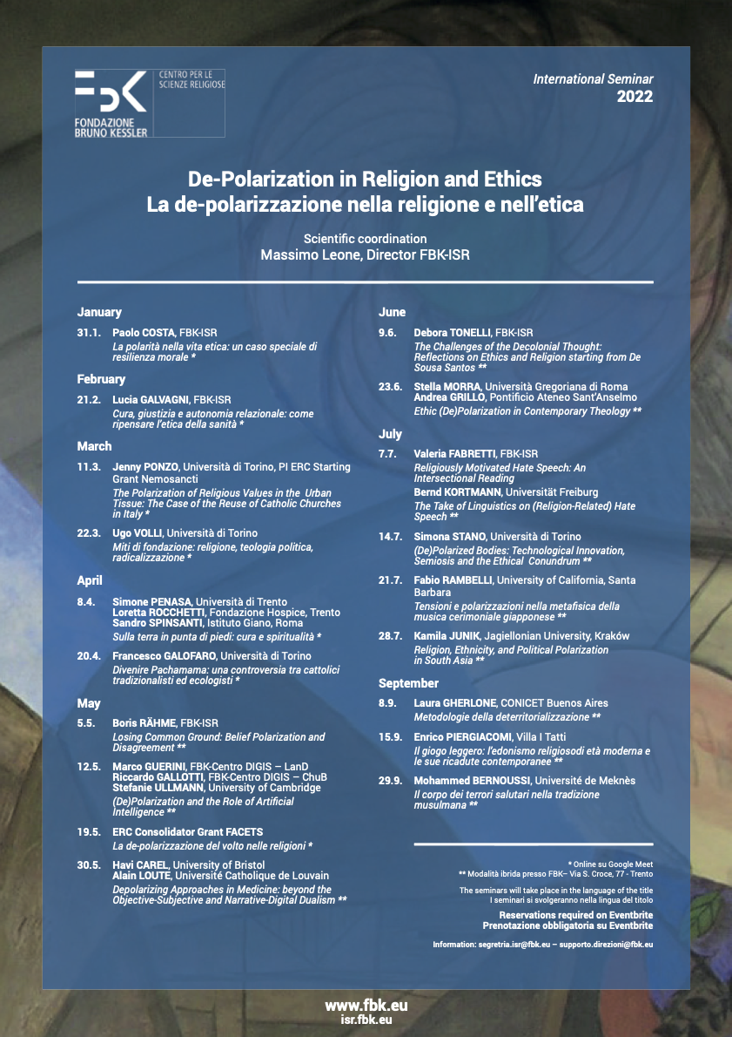
2022 in detail
International Seminar
Seminar on “De-Polarization in Religion and Ethics”, 20 talks, international Speakers from the 5 continents.
page 18

Slide 19
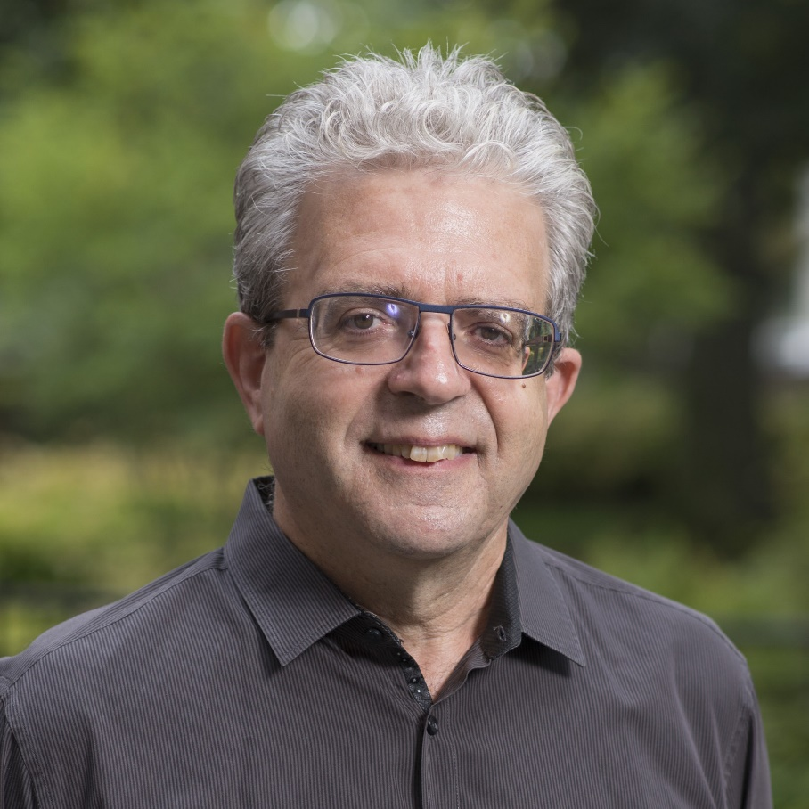
2022 in detail Key Events, 01
Panel in the Congress of the International Association for Semiotic Studies, “A Whole Lifeworld in a Room”, 31 August 2022
Panel in the Congress of the European Academic of Religion, “De-Polarization in Religion and Ethics”, 21 June 2022
Prof. Robert A. Orsi
Grace Craddock Nagle Chair of Catholic Studies at Northwestern University
ZORDAN Lecture
24 October 2022
page 19

Slide 20
2022 in detail Key Events, 02
page 20

Slide 21
2022 in detail Key Publications
New book series with Artigianelli for content dissemination
and for recomposing the Zordan Lectures
October 2022 Issue of the Annali
New peer-reviewed series of book for publishing a selection of the 2022 seminars papers.
page 21

Slide 22
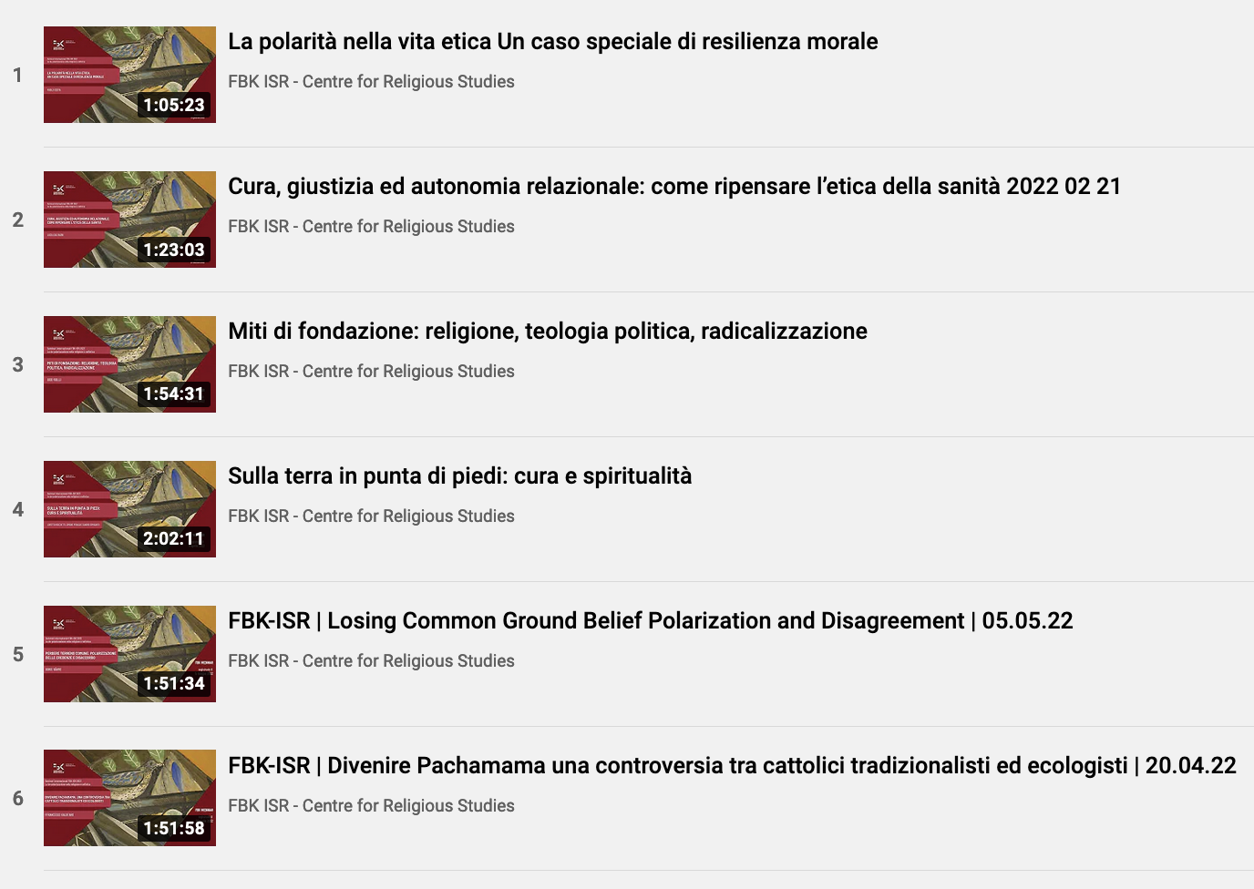
2022 in detail Key Dissemination
Podcasts
Qualified
Social Networks
Videos
page 22

Slide 23
2022 in detail Key Partners
University of Trent
University of Turin
Luxembourg School of Religion and Society
Shanghai University
UC Berkeley - GTU
page 23

Slide 24
2022 in detail
Doctoral Program
The transversal curriculum aims to promote research concerning the interdisciplinary and comparative analysis of religion, religions, spirituality, through an innovative but rigorous intersection of historical, anthropological, sociological, psychological, philosophical and semiotic skills and with particular attention to collaboration with scientific and technological knowledge (religion and evolution; religion and cognition; religion and materiality; religion and technology, with emphasis on the relationship with digital, artificial intelligence, robotics, artificial life).
ISR-FBK leads the section on interdisciplinariety and contributes with one scholarship.
page 24

Slide 25
Conclusions

Slide 26
Conclusions: Keywords
INTERWEAVE
Promoting sinewy cooperation
Among researchers
With other FBK centers
With international partners
INTERSPERSE
Promoting robust dissemination
Through academic products and events
Through qualified digital outputs
Through engagement with stakeholders and the territory
INTERCEPT
Promoting frontier research
Main global research trends on religion
Burning societal questions
Training Doctoral and Post-Doctoral talents
page 26

Slide 27
Conclusions: Expansion lines
INTERWEAVE
Promoting sinewy cooperation
Increase of human resources (through internal sustainable opportunities and through external international projects)
Requalification of human resources (through advanced training)
Revamping of human resources (through sustainable professional dynamicity)
INTERSPERSE
Promoting robust dissemination
Increase of strategic publications (through new publication outlets)
Remodeling of dissemination outputs (in line with new generation audiences)
Restructuring of research lines (through aggregation in maximum impact research platforms)
INTERCEPT
Promoting frontier research
Through anticipating ethical needs in future frontier research
Through intense internal and international synergy
Training privileging High-Risk / High Gain early stage career projects
page 27

Slide 28
Thank you

